Slide 1
NYU Processor 6364
ACHD Final Project - I
By: Dan Wu, Kush Agarwal, Madhumita Sawant, Monica Reddy Tirupari, Shubham Mahalank, Xinmei Jin, Zhaoxi Chen

Slide 2
Work Completed in Part 1
Designing of components
Instruction Memory (IM)
Register File (RF)
Arithmetic Logic Unit (ALU)
Data Memory (DM)
Decoder
B) Combining Components
We have combined all the components to make Single cycle MIPS Architecture.
C) Functional Simulation:
Functional simulation of every component was done(using Test Benches) , along with functional simulation of the combined MIPS architecture.
D) Verifying
We verified our newly developed processor using the 2 Sample codes provided to us in the project description file.
E) RC5 Code
Have designed the code in Assembly language and tested it.

Slide 3
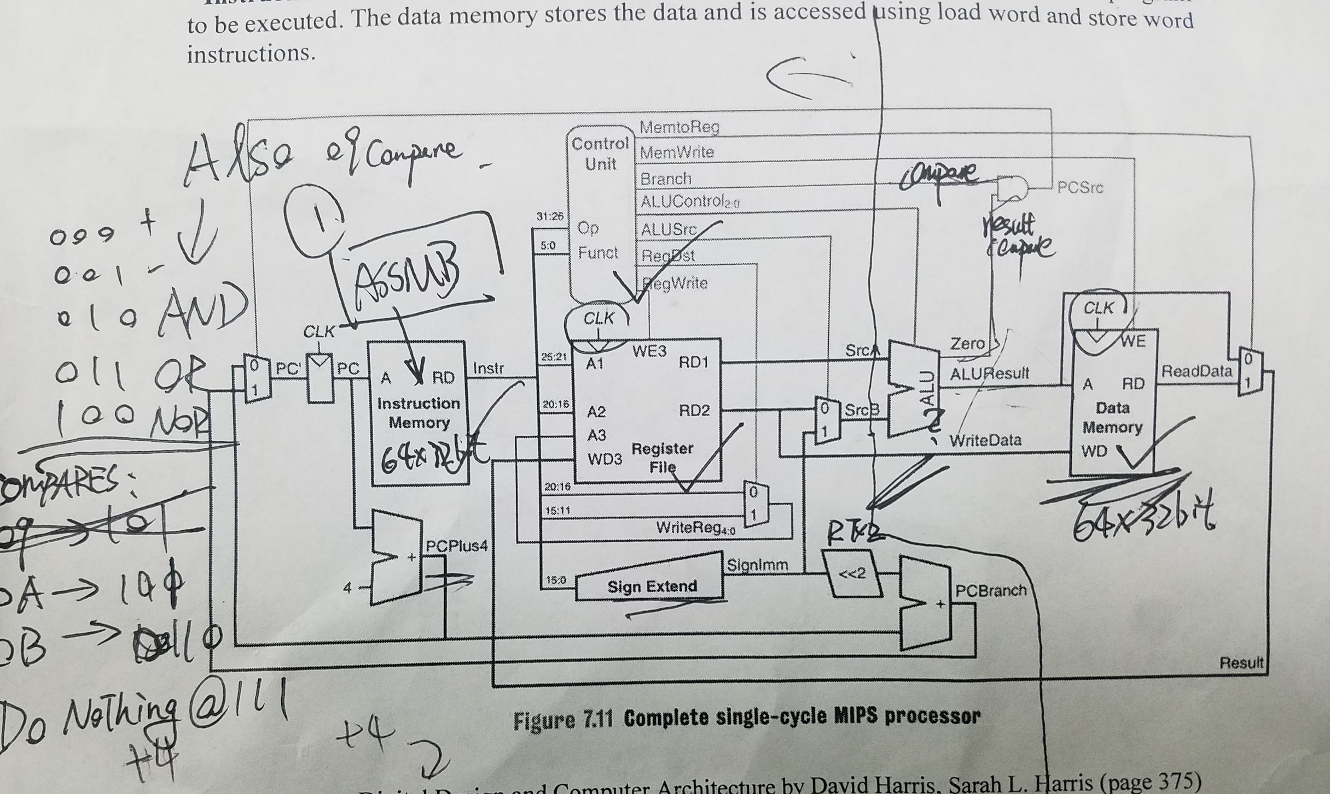
Architecture

Slide 4
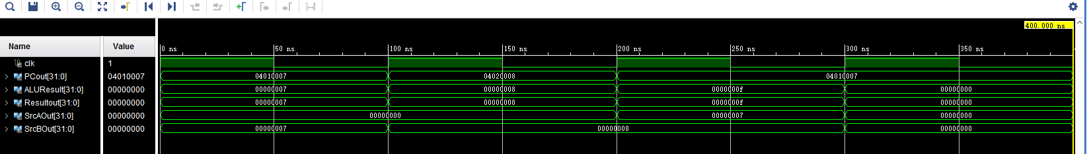
Output Verification
Sample Code:
ADDI R1, R0, 7 ////R0=0, R1=R0+7, R1=7
ADDI R2, R0, 8 ////R2=R0+8,R2=8
ADD R3, R1, R2///R3=R1+R2, R3=15(F)
HAL
We can see , We get R1=7 ; R2= 8 and combined Result R3=F.
Working correctly.

Slide 5
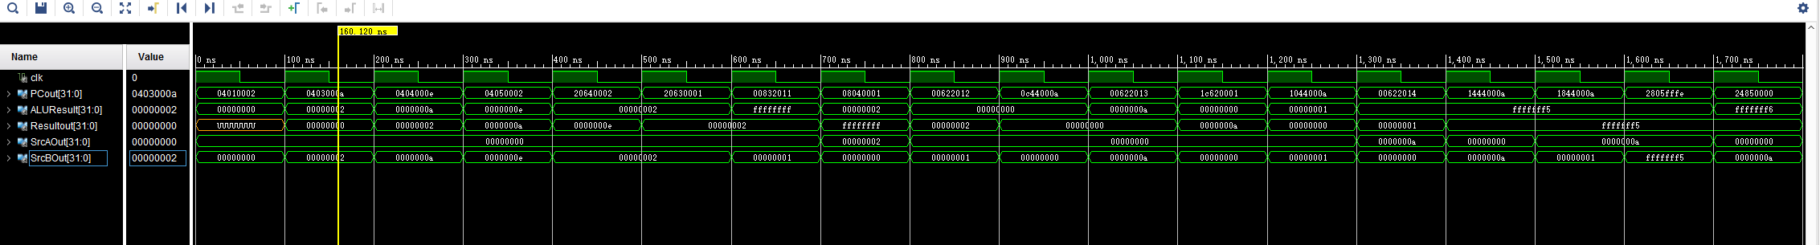
Sample code 2 simulation output

Slide 6
RC5 keyexpansion Assembly
addi $0, $10, 26
addi $0, $11, 4
addi $0, $12, 78
lw $6, $3, 0
hal
add $3, $1, $9
add $9, $2, $9
shl $9, $9, 3
add $0, $9, $1
sw $6, $1, 0
hal
add $1, $2, $8
andi $8, $8, 31
lw $7, $4, 26
hal
add $4, $1, $9
add $9, $2, $9
beq $0, $8, 3
shl $9, $9, 1
subi $8, $8, 1
bne $0, $8, -3
add $0, $9, $2
sw $7, $2, 26
hal
addi $6, $6, 1
addi $7, $7, 1
bne $6, $10, 1
sub $6, $6, $6
bne $7, $11, 1
sub $7, $7, $7
addi $5, $5, 1
bne $5, $12, -29

Slide 7
ENCRYPTION
DECRYPTION
lw $0, $3, 0
add $1, $3, $1
lw $0, $4, 1
add $2, $4, $2
addi $0, $12, 12
or $1, $2, $4
and $1, $2, $5
sub $4, $5, $4
andi $2, $5, 31
addi $6, $6, 1
beq $0, $5, 3
SHL $4, $4, 1
SUBI $5, $5, 1
BNE $0, $5, -3
SHL $6, $7, 1
LW $7, $3, 0
hal
ADD $4, $3, $1
OR $1, $2, $4
and $1, $2, $5
sub $4, $5, $4
andi $1, $5, 31
beq $0, $5, 3
shl $4, $4, 1
subi $5, $5, 1
bne $0, $5, -3
addi $7, $7, 1
lw $7, $3, 0
hal
add $4, $3, $2
bne $12, $6, -26
hal
addi $0, $12, 12
shl $12, $13, 1
addi $13, $14, 1
lw $14, $3, 0
hal
sub $2, $3, $2
andi $1, $4, 31
beq $0, $4, 3
shr $2, $2, 1
subi $4, $4, 1
bne $0, $4, -3
or $1, $2, $5
and $1, $2, $6
sub $5, $6, $2
sub $3, $3, $3
lw $13, $3, 0
hal
sub $1, $3, $1
andi $2, $4, 31
beq $0, $4, 3
shr $1, $1, 1
subi $4, $4, 1
bne $0, $4, -3
or $1, $2, $5
and $1, $2, $6
sub $5, $6, $1
subi $12, $12, 1
bne $12, $0, -27
sub $3, $3, $3
lw $0, $3, 1
hal
sub $2, $3, $2
sub $3, $3, $3
lw $0, $3, 0
hal
sub $1, $3, $1
hal

Slide 8
Future Work:
Timing simulation of processor.
Timing and Area Analysis.(Synthesis and Place and Route Analysis)
Running RC5 code on the newly designed Processor.

